Slide 1

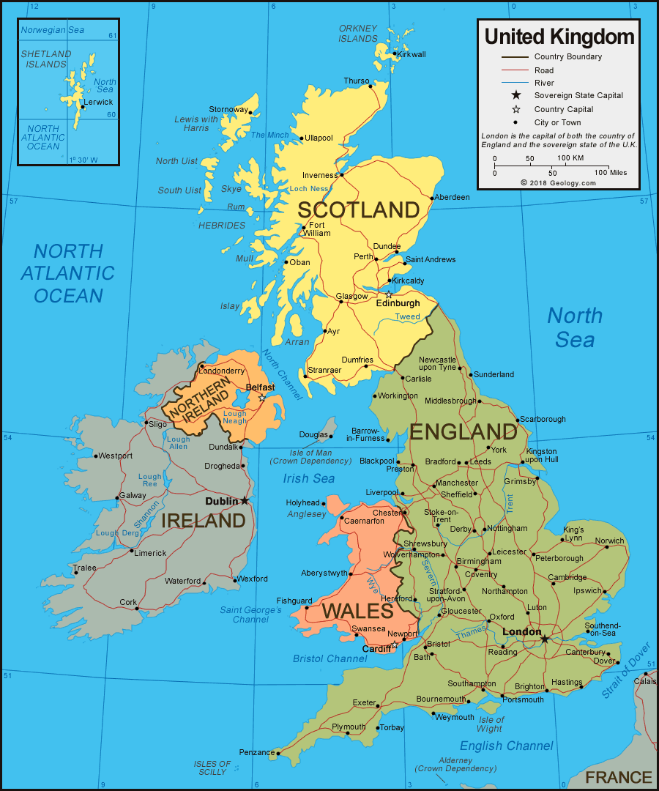
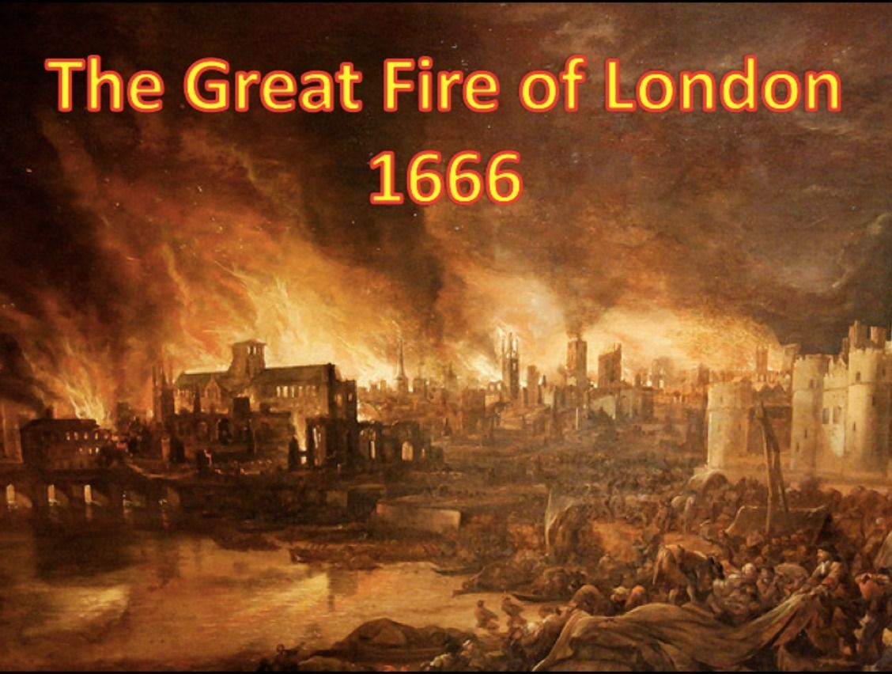
In Year 2 we will be exploring Me and My Country, which will include learning about the UK and The Great Fire of London
The Great Fire of London (Jane Bingham) The Lion in the Meadow (Margaret Mahy) Harvey Slumfenberger’s Christmas Present (John Burningham)
Examples of some texts that will be used:

Slide 2

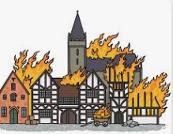
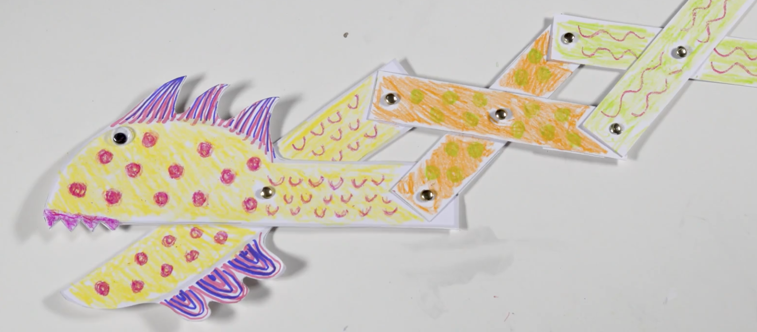

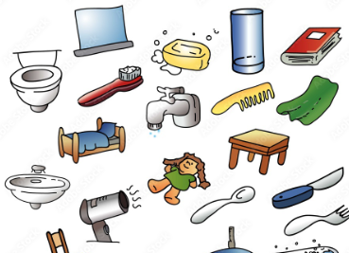
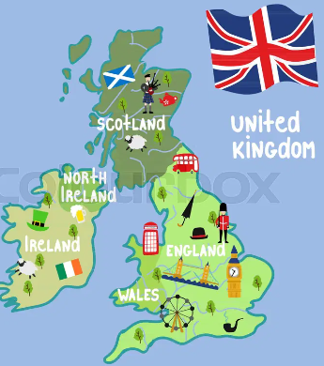

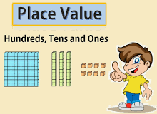
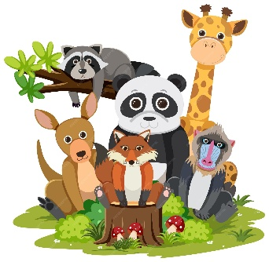
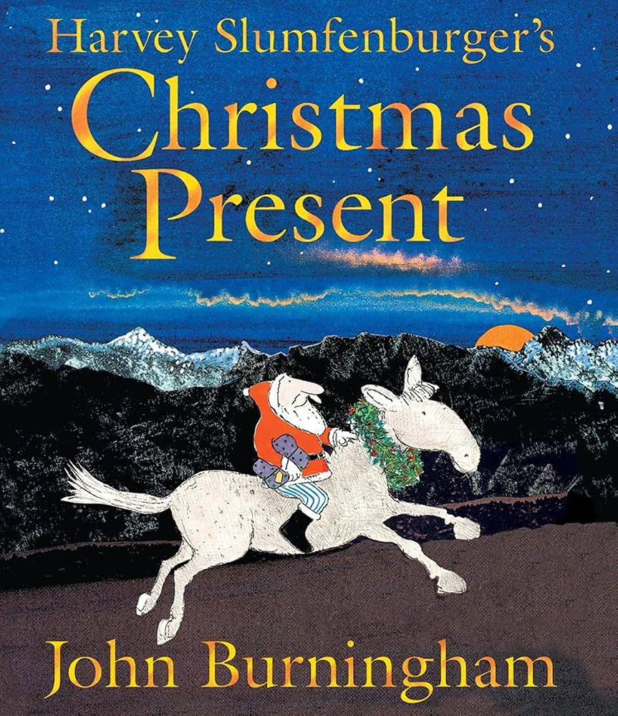







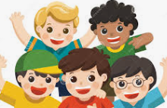
What I am learning in Year 2
Autumn Term 2026
English | Mathematics | Science | Drama | History | Geography | Design Technology
We will focus on these stories and use them to help with our writing. | We will learn about place value, addition and subtraction, and shape | We will learn about Materials and Animals including humans. | We will role play historical events such as what it would have been like during the Great Fire of London. | The Great Fire of London | We will learn about the Local area and United Kingdom and its Seas | We will learn about Mechanisms: Making a moving monster
 |  |  | RE | Music | Computing | PE | RSHE
 |  |  | We will think about: Why do we need to give thanks? Why is light important to people? | We will listen to different styles of music and learn songs together | We will learn about technology around us and talk about the importance of E- Safety | We will learn basketball, hockey, dance and dodgeball. | My Heathy Self- How can we look after our bodies? Connecting with others- How can I build safe, kind and caring relationships?

