Slide 1


As you will have read in June’s newsletter our latest fund raising project is to raise money to buy and kit out a sensory space in
school.
We want it to be a special area. Rather than adapting one of our intervention spaces within the school building. Our aim is to enhance the school further and have a totally separate space.
The area will have a name and all the children will have access to it when needed – we are undecided on it’s name at the moment but a few thoughts are – sensory shed, sensory den, sensory pod ….
Potentially this is a competition in the making – the children will
no doubt have many ideas.

Slide 2

This is one option of the kind of structure we are looking at buying or ……

Slide 3
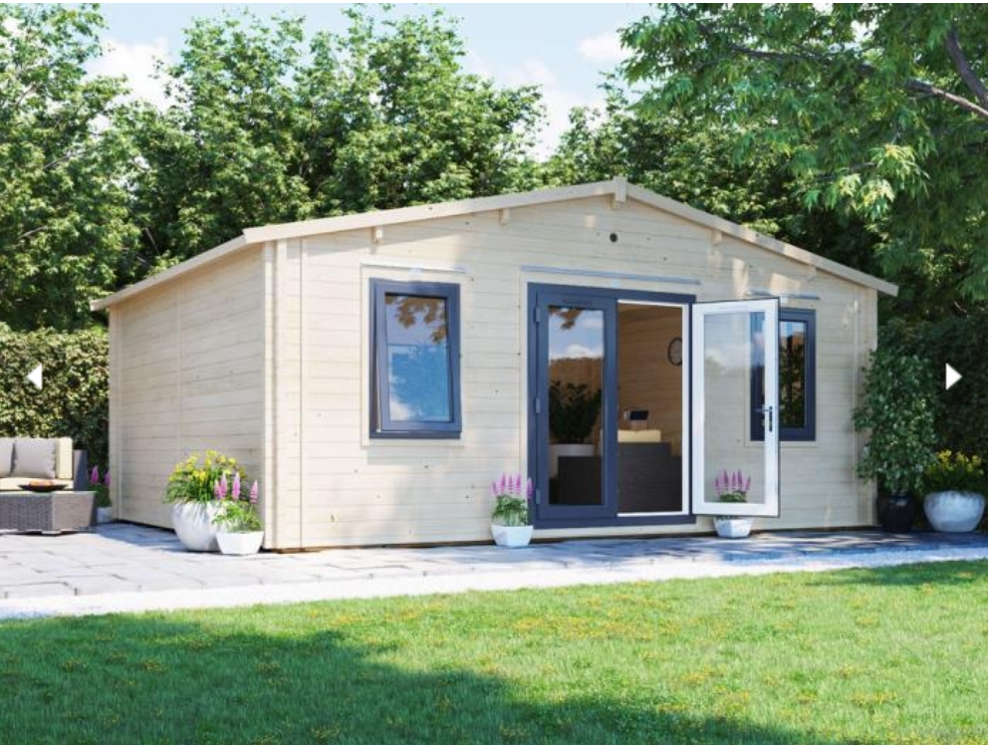
…. something like this.

Slide 4
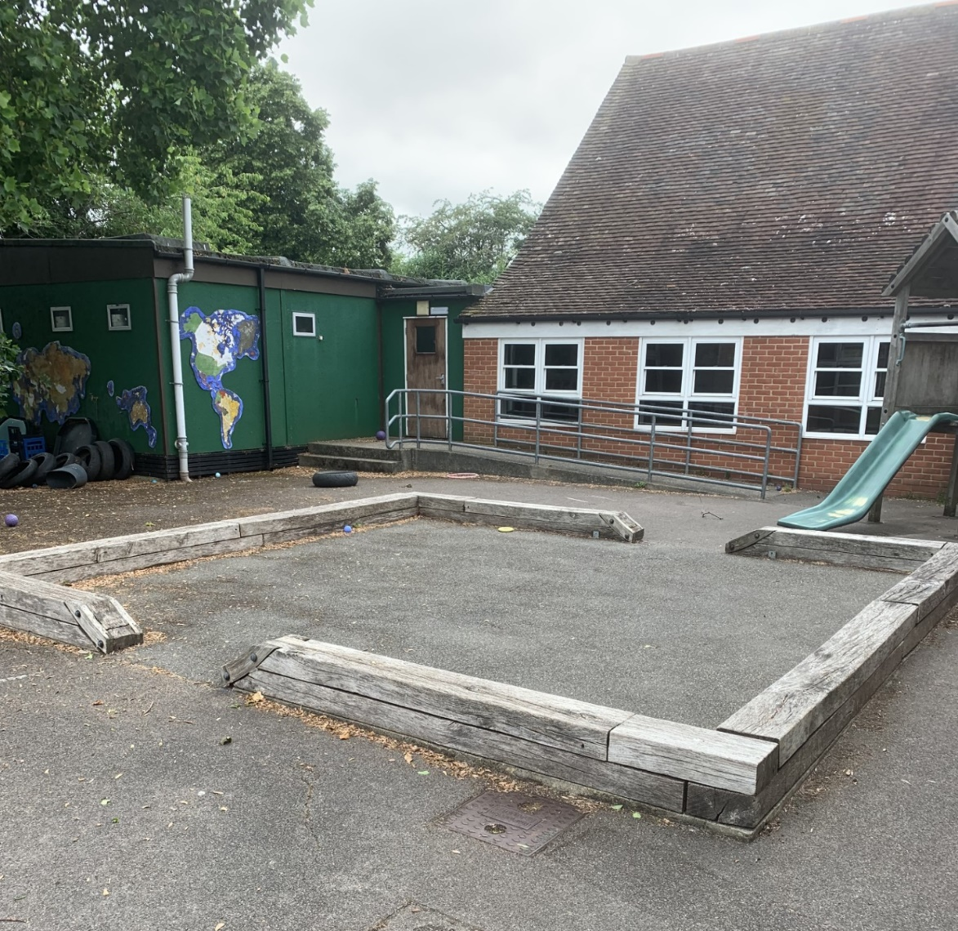
This is the area we intend to put the ’sensory pod / shed / den’

Slide 5
The goal of a sensory room is to provide a calming place for all, including children with sensory needs. Children can go there when they need to either calm or stimulate their senses.
They can be as varied as the people who use them.
Sensory rooms provide a great variety of activities to help engage the senses.
Sensory rooms provide a great variety of activities to help engage the senses.

Slide 6
Children may have sensory needs if they are sensitive to sound, touch, taste, smell, visuals or movements.
Sensory play is beneficial for children as it helps them engage with the world and develop their brain’s pathways.
Children may react differently to sensory input, depending on whether they are sensory seekers or sensory avoiders.
Sensory seekers need more stimulation, while sensory avoiders needs less.

Slide 7
Benefits of Sensory Play
Encourages problem solving. As children manipulate objects and explore through their senses, they are developing key strategies to problem solve.
Increases brain development.
Better retention.
Provides sensory input.
Regulation of emotions and behaviour.
Language development.
Improves fine motor skills.
Sparks and interest in learning.

Slide 8
What are the benefits of a sensory room.
Many hidden benefits exist when using a sensory room. Children with sensory and other cognitive and physical disabilities often feel empowered when controlling the environment around them
A sensory room allows users to use what ever piece of equipment they need at that time. For example, someone may have difficulty when overstimulated by noise. They can enter a sensory room and use the items they feel would best make them comfortable and more in control of their body’s regulation.
After spending time in the sensory room, users often enjoy increased concentration and focus, improved creativity and expression, increases fine and gross motor skills and promotes calmer behaviours.
Another example is when a child constantly engages in sensory seeking
behaviour, they may need more input in order to stay focused – they may
then use weighted items to know where they are in the wider space

Slide 9

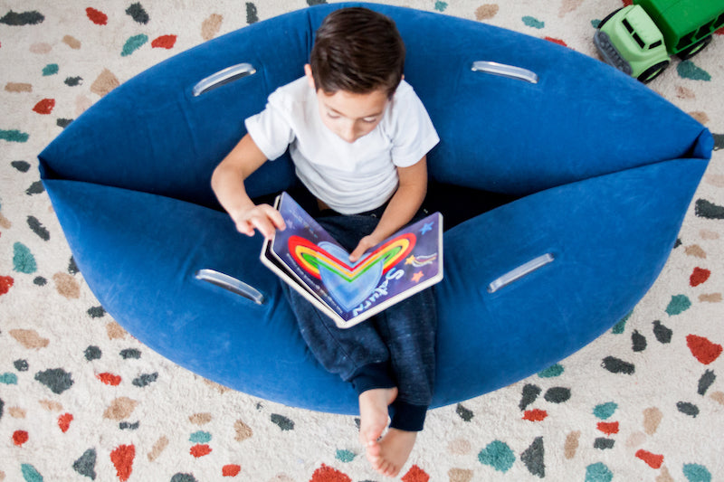

Items there may be in a sensory room.
Massage equipment
Lighting that slowly changes colours
Bubble tubes
Calming scents
Music
Weighted blankets
Bean bags
Fidget toys
Swing
Sensory seating

Slide 10
We have set up a fundraising page to help raise funds for this project. If anyone would be happy to donate please do – all contributions will help – thank you. We have a Just Giving Page at www.justgiving.com/crowdfunding/SmileAndMoulshamInfantSchool

