Slide 1




In Year 1 we will be focusing on the ‘Our amazing world!’
Planet Awesome,
Examples of some texts that will be used:

Slide 2
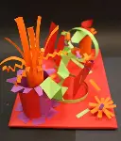
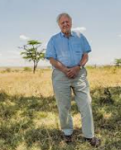
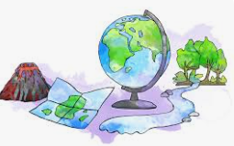
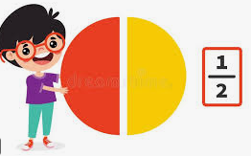

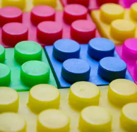


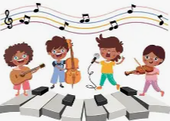
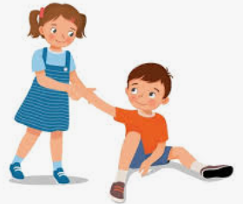
What I am learning in Year 1
Summer Term 2026
English | Mathematics | Science | Drama | History | Geography | Art & DT
We will focus on these stories and use them to help with our writing. We will use simple pictures to help us write sentences. | We will learn about multiplication and division, fractions, time, money and shape. | We will learn how to identify and name a variety of everyday materials, including wood, plastic, glass, metal, water and rock. We will learn about animals including humans. | We will role play stories, hot seat characters and practice speaking in front of the class. | We will learn about environmentalists who have changed history. | We will learn about human and physical feature and create simple maps. | We will be creating sculptures using a range of media. We will examine how nature is portrayed through art.
 |  |  | RE | Music | Computing | PE | RSHE
 |  |  | We will learn about how different religions welcome new babies, and we will think about how we care for others. | We will listen to different styles of music and learn songs together | We will learn how to control a simple robot and will find out how to use the computers to create digital writing. | We will learn gymnastics, athletics and cricket. | We will learn about citizenship. We will prepare for our move to Year 2.

